Slide 1



guvi2
View in Power BI
Last data refresh:
4/12/2024 11:05:15 AM UTC
Downloaded at:
4/12/2024 11:08:18 AM UTC

Slide 2
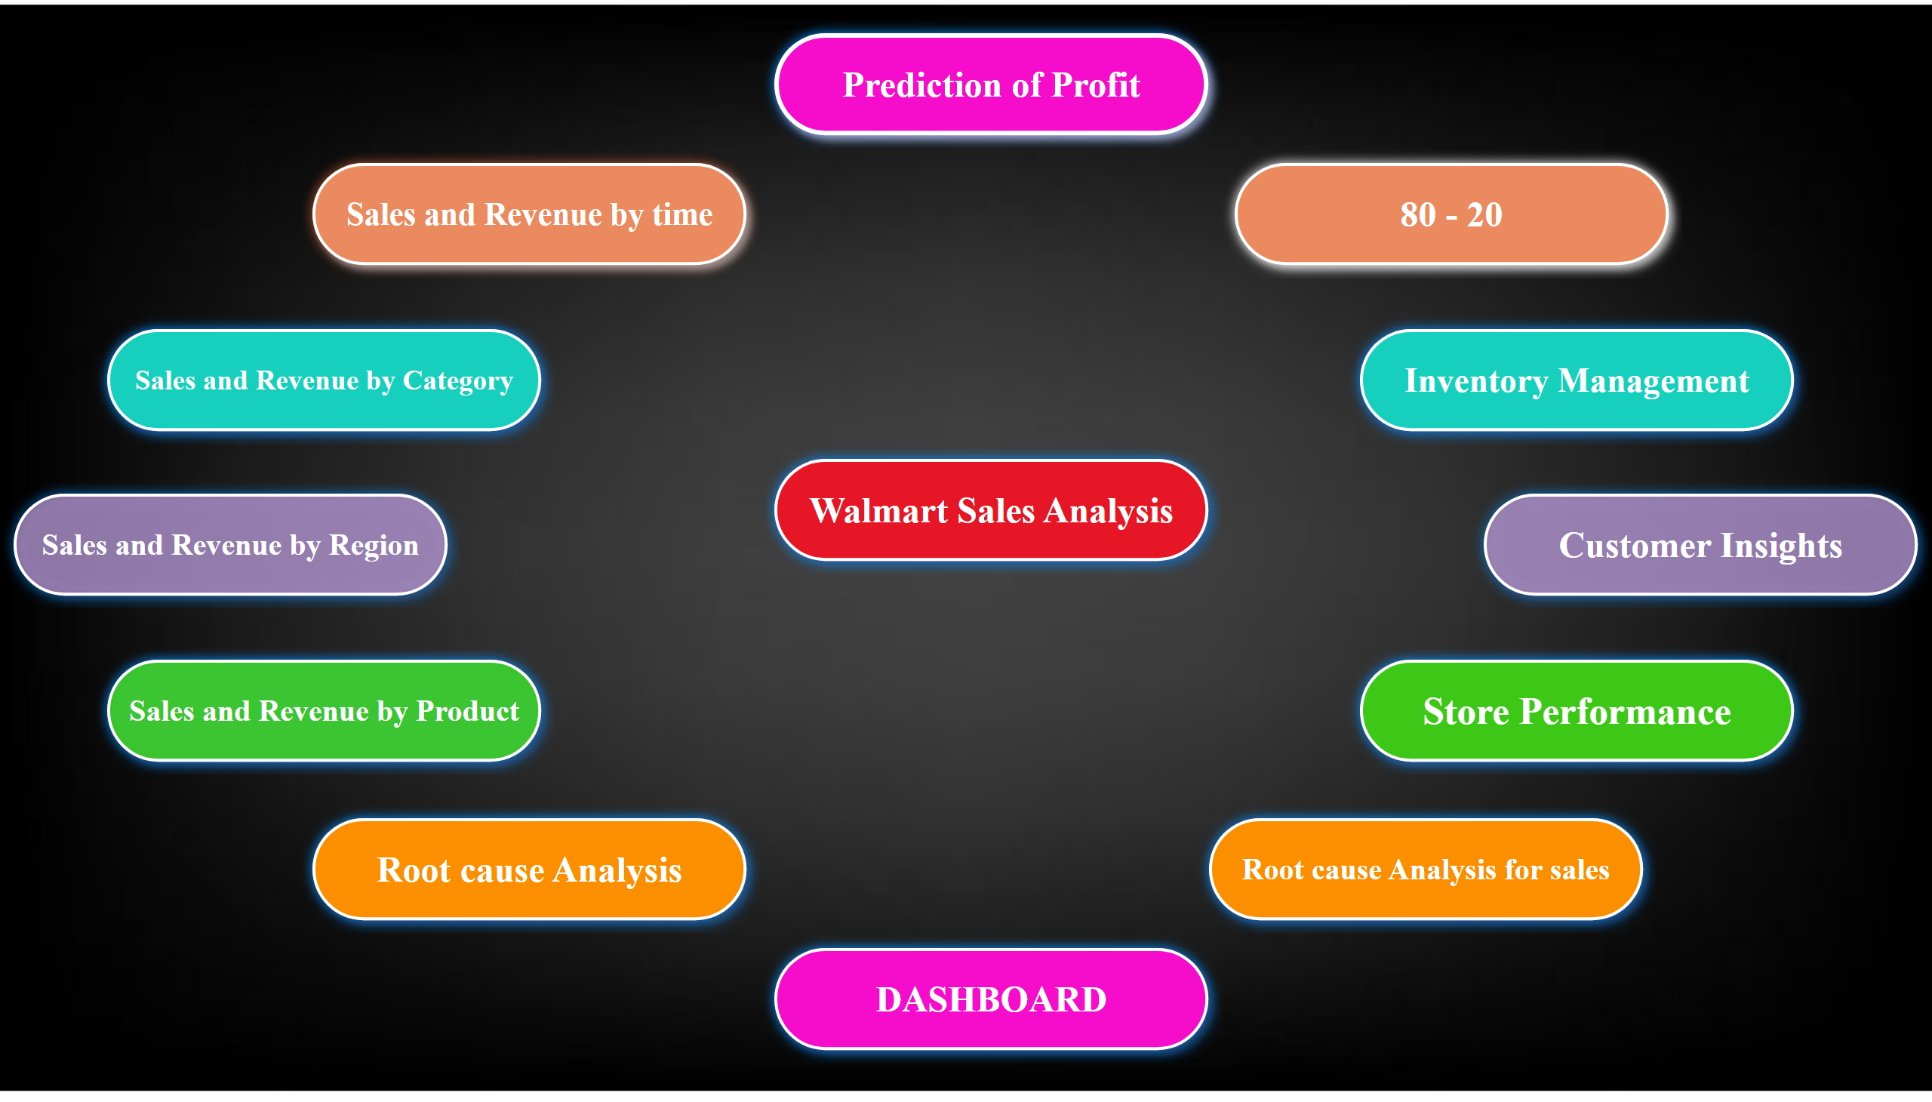
HOME
Notes:
actionButton
No alt text provided
actionButton
No alt text provided
actionButton
No alt text provided
actionButton
No alt text provided
actionButton
No alt text provided
actionButton
No alt text provided
actionButton
No alt text provided
actionButton
No alt text provided
actionButton
No alt text provided
actionButton
No alt text provided
actionButton
No alt text provided
actionButton
No alt text provided
actionButton
No alt text provided

Slide 3
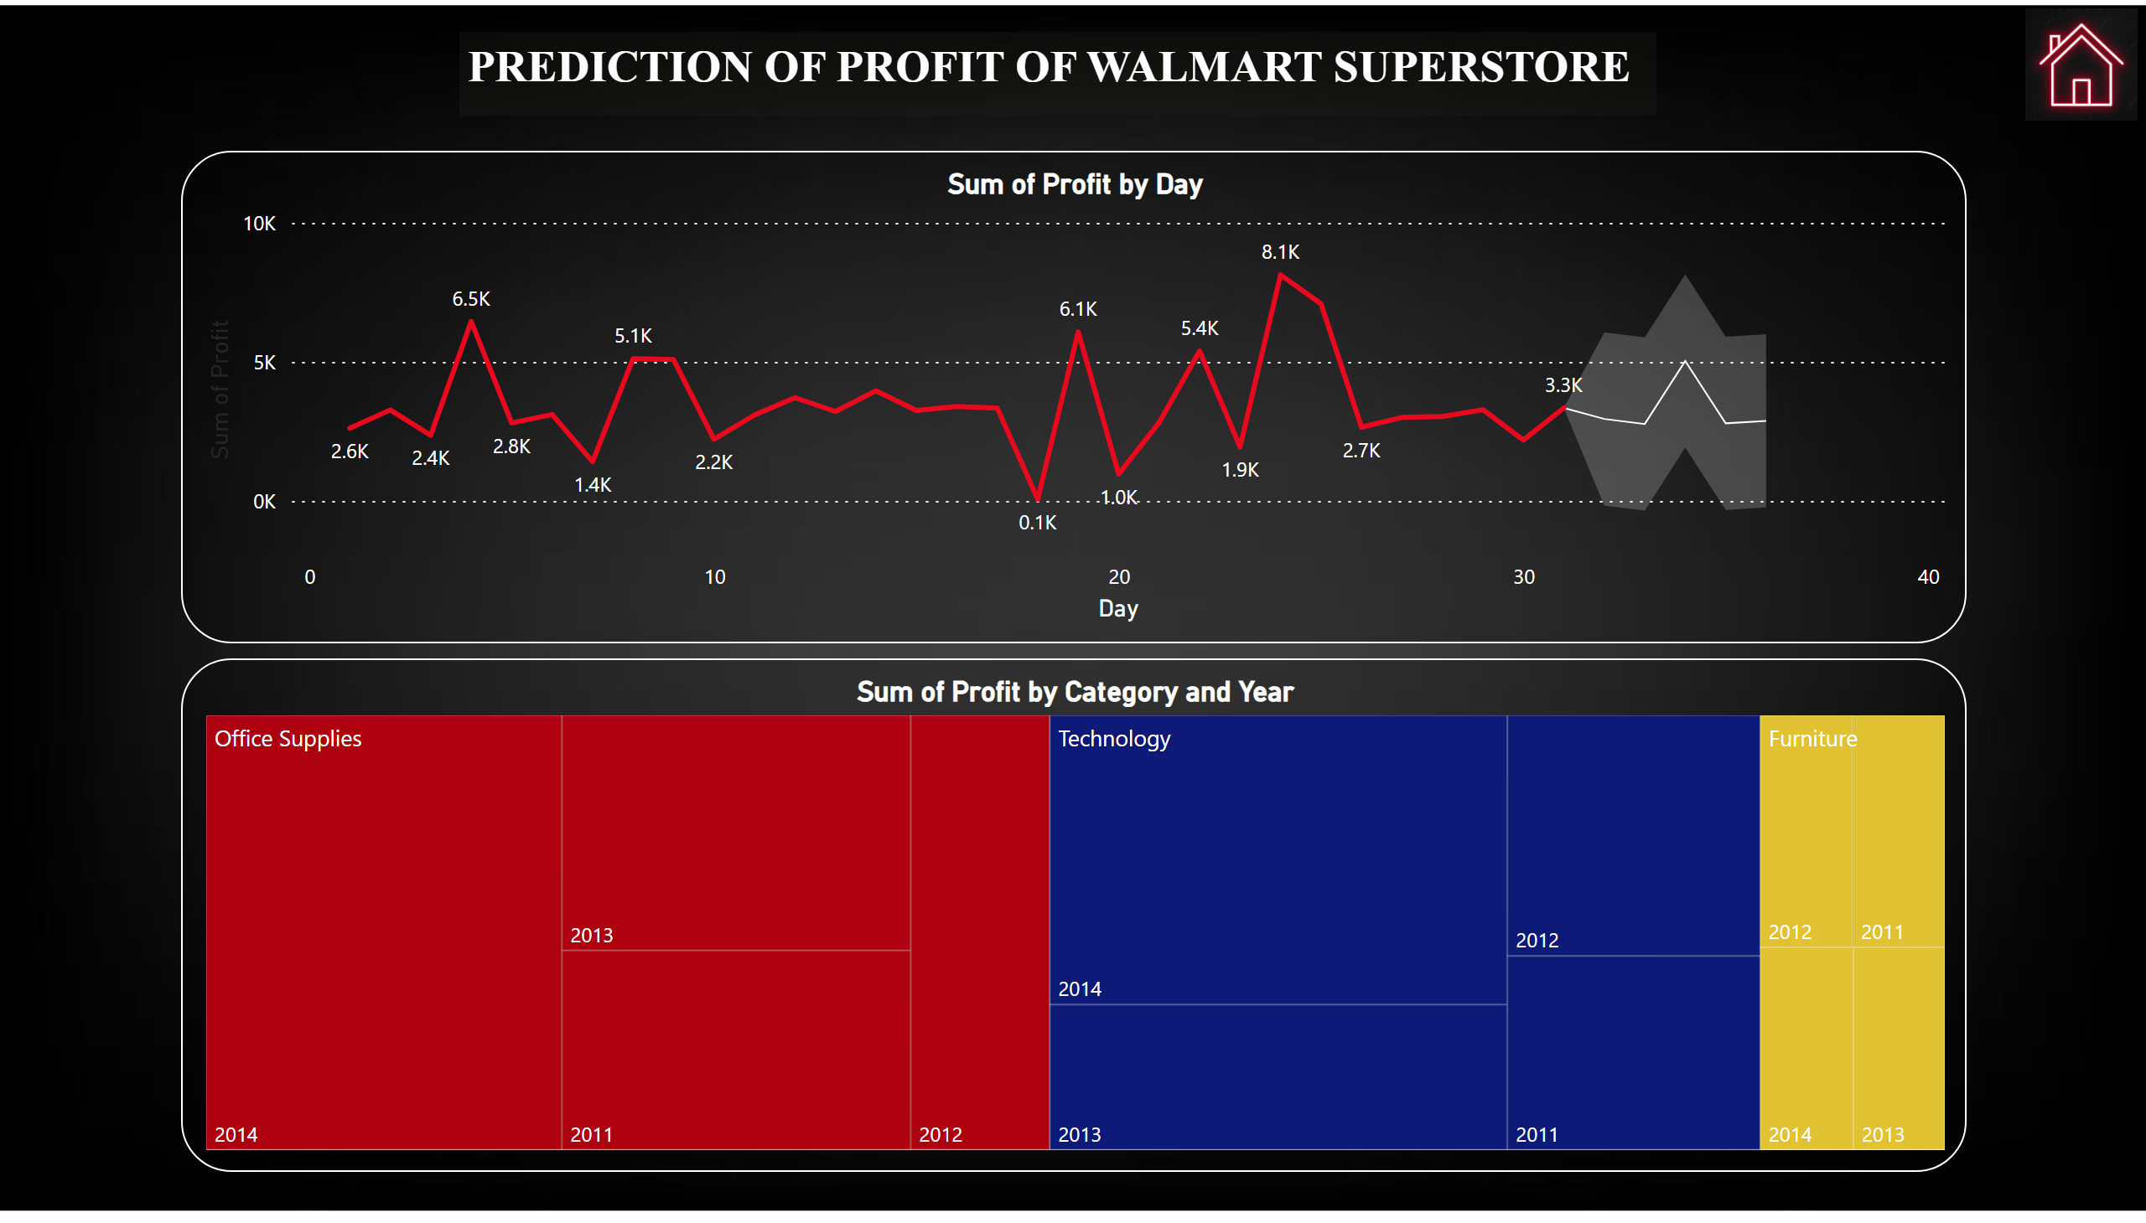
Prediction of Profit
Notes:
lineChart
No alt text provided
treemap
No alt text provided
textbox
No alt text provided
image
No alt text provided

Slide 4
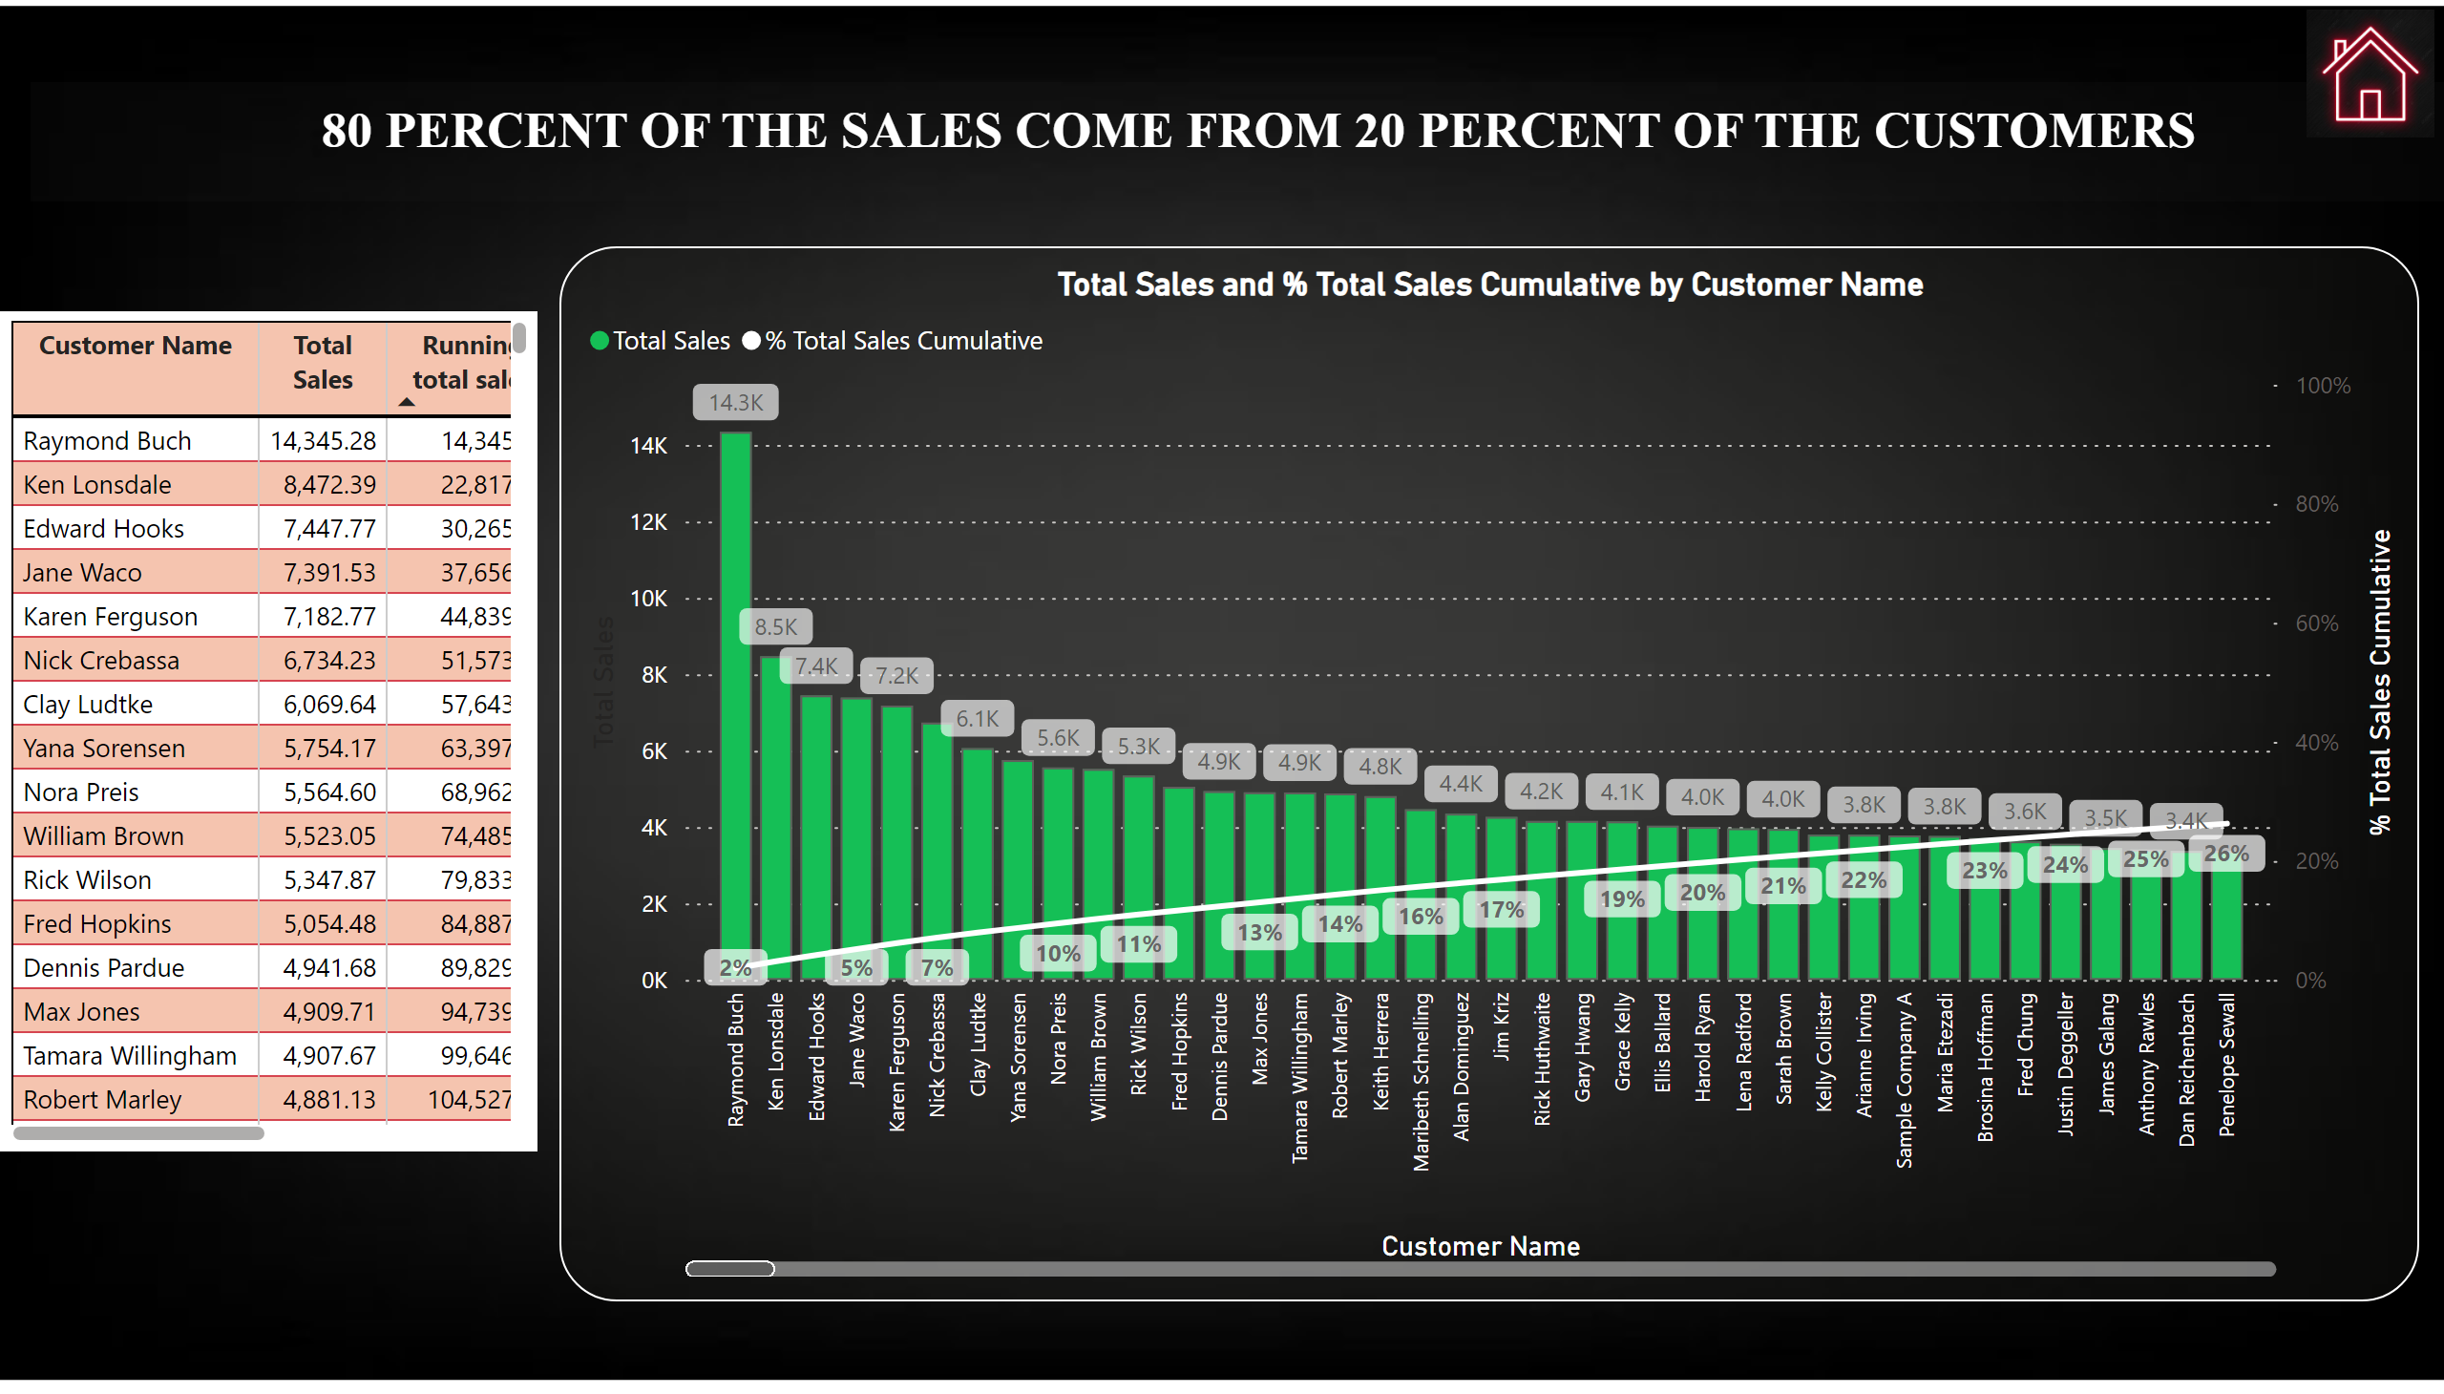
80 - 20
Notes:
tableEx
No alt text provided
lineClusteredColumnComboChart
No alt text provided
textbox
No alt text provided
image
No alt text provided

Slide 5
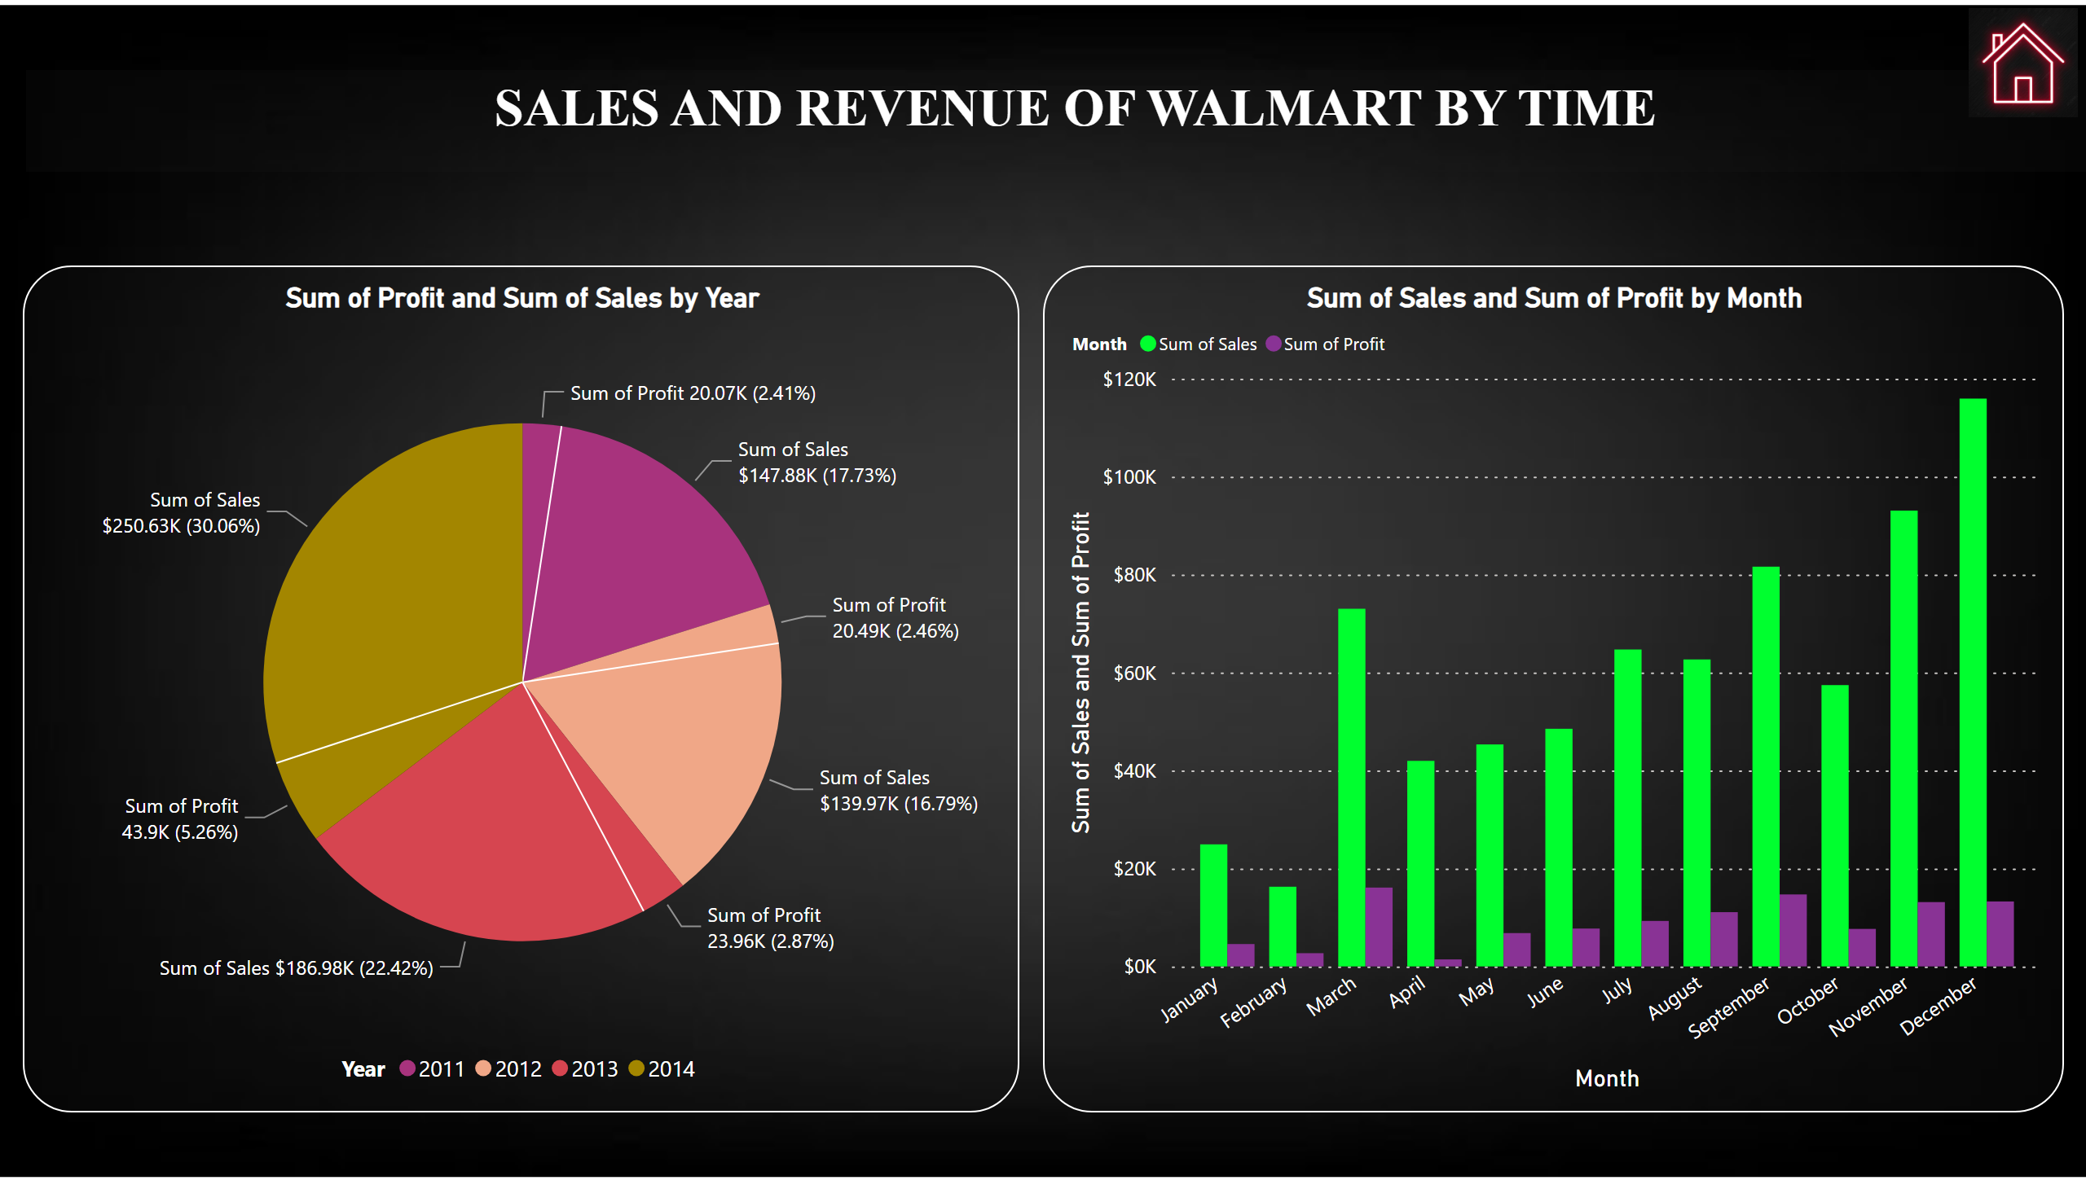
Sales and Revenue by time
Notes:
pieChart
No alt text provided
clusteredColumnChart
No alt text provided
textbox
No alt text provided
image
No alt text provided

Slide 6
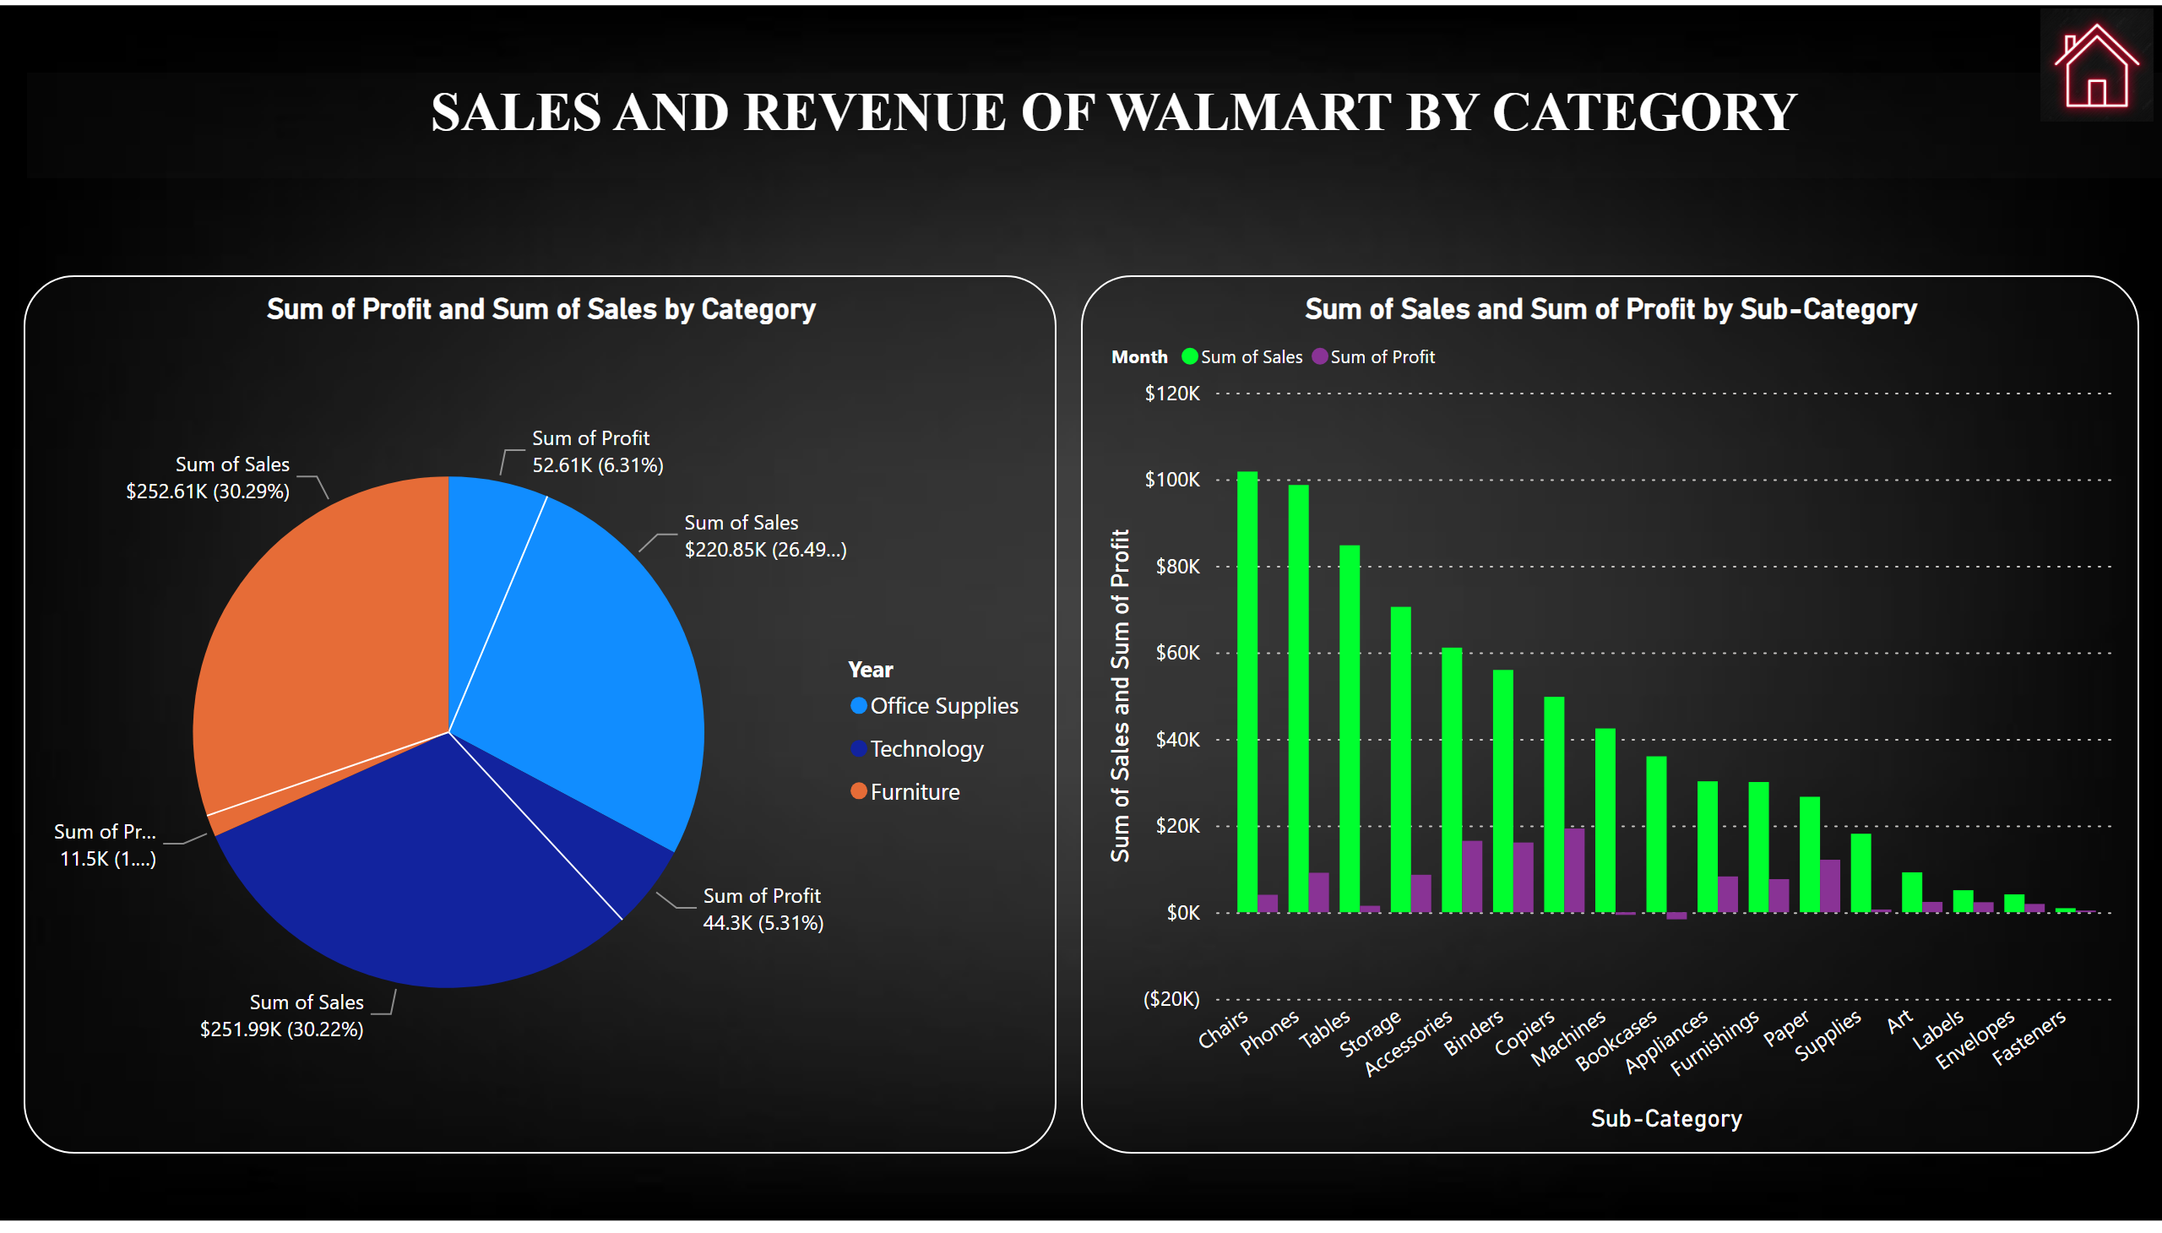
Sales and Revenue by Category
Notes:
pieChart
No alt text provided
clusteredColumnChart
No alt text provided
textbox
No alt text provided
image
No alt text provided

Slide 7
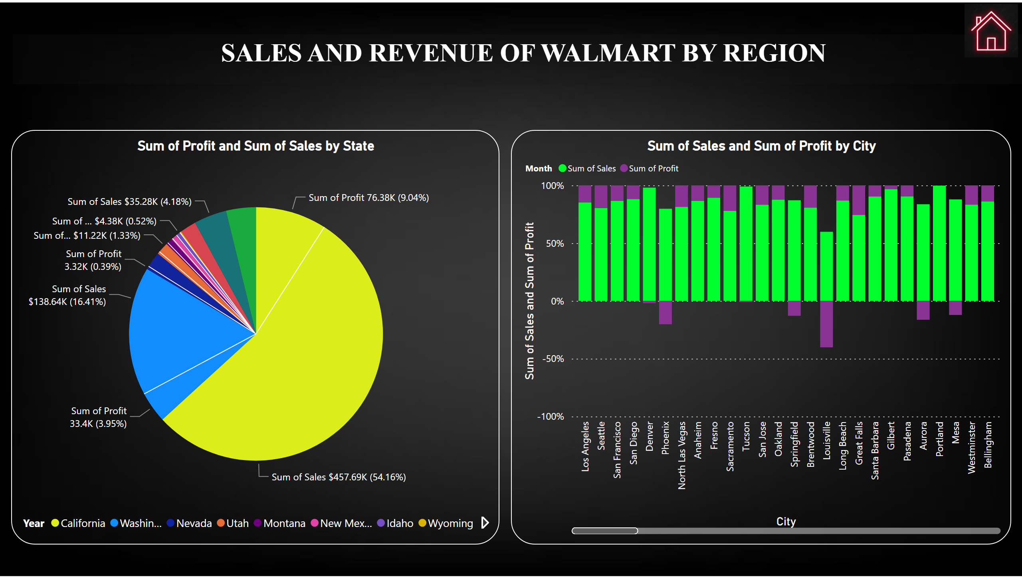
Sales and Revenue by Region
Notes:
pieChart
No alt text provided
hundredPercentStackedColumnChart
No alt text provided
textbox
No alt text provided
image
No alt text provided

Slide 8
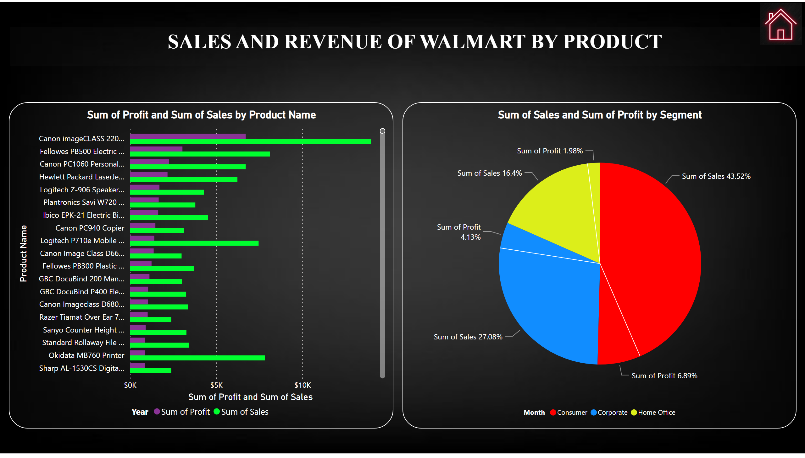
Sales and Revenue by Product
Notes:
clusteredBarChart
No alt text provided
pieChart
No alt text provided
textbox
No alt text provided
image
No alt text provided

Slide 9
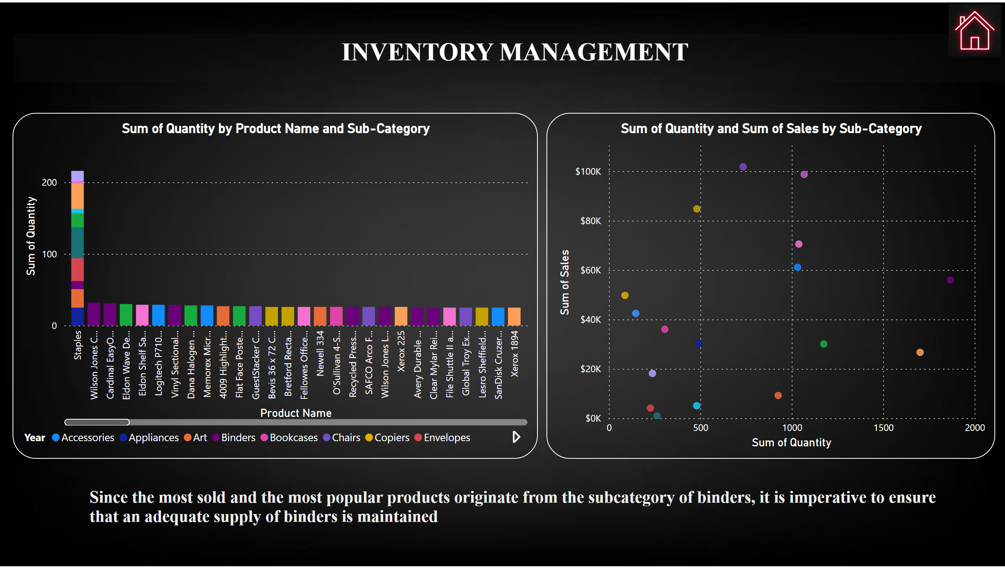
Inventory Management
Notes:
columnChart
No alt text provided
textbox
No alt text provided
scatterChart
No alt text provided
textbox
No alt text provided
image
No alt text provided

Slide 10
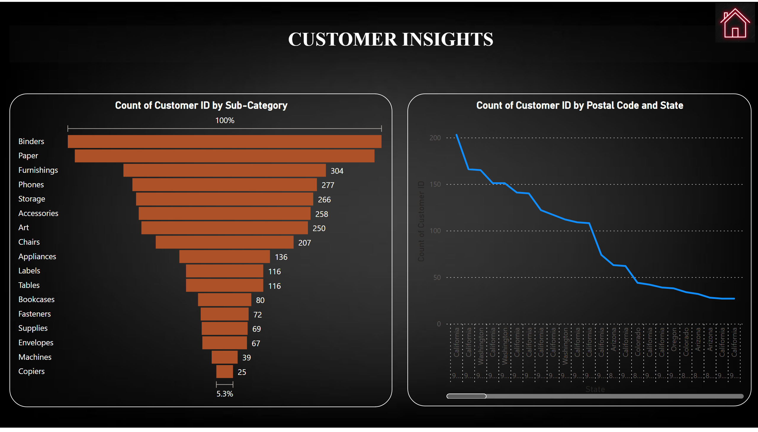
Customer Insights
Notes:
funnel
No alt text provided
textbox
No alt text provided
image
No alt text provided
lineChart
No alt text provided

Slide 11
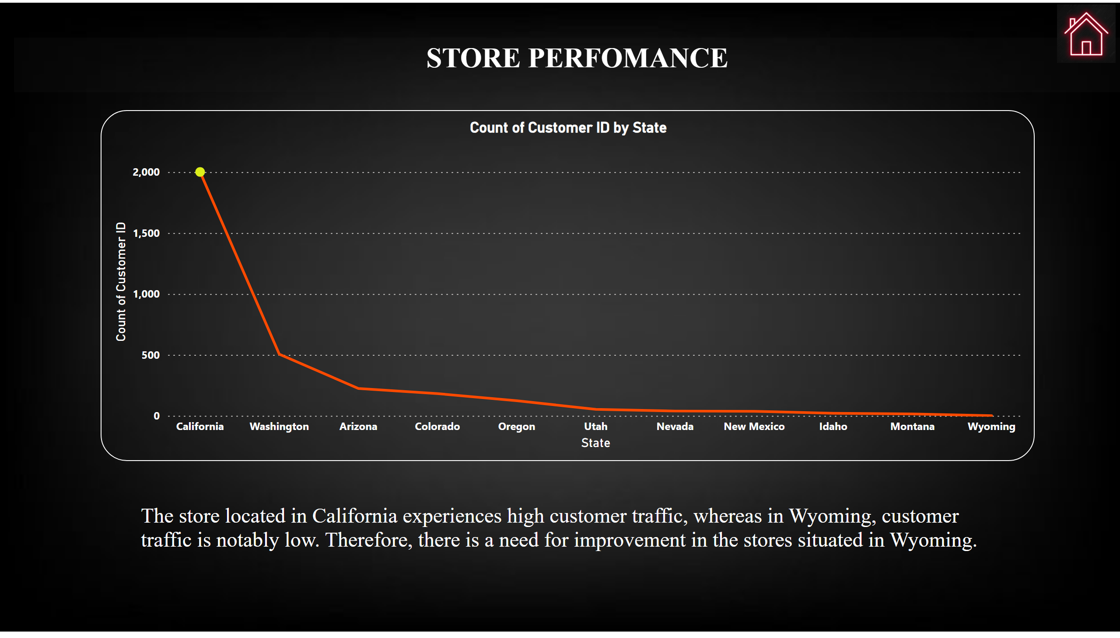
Store Performance
Notes:
lineChart
No alt text provided
textbox
No alt text provided
textbox
No alt text provided
image
No alt text provided

Slide 12
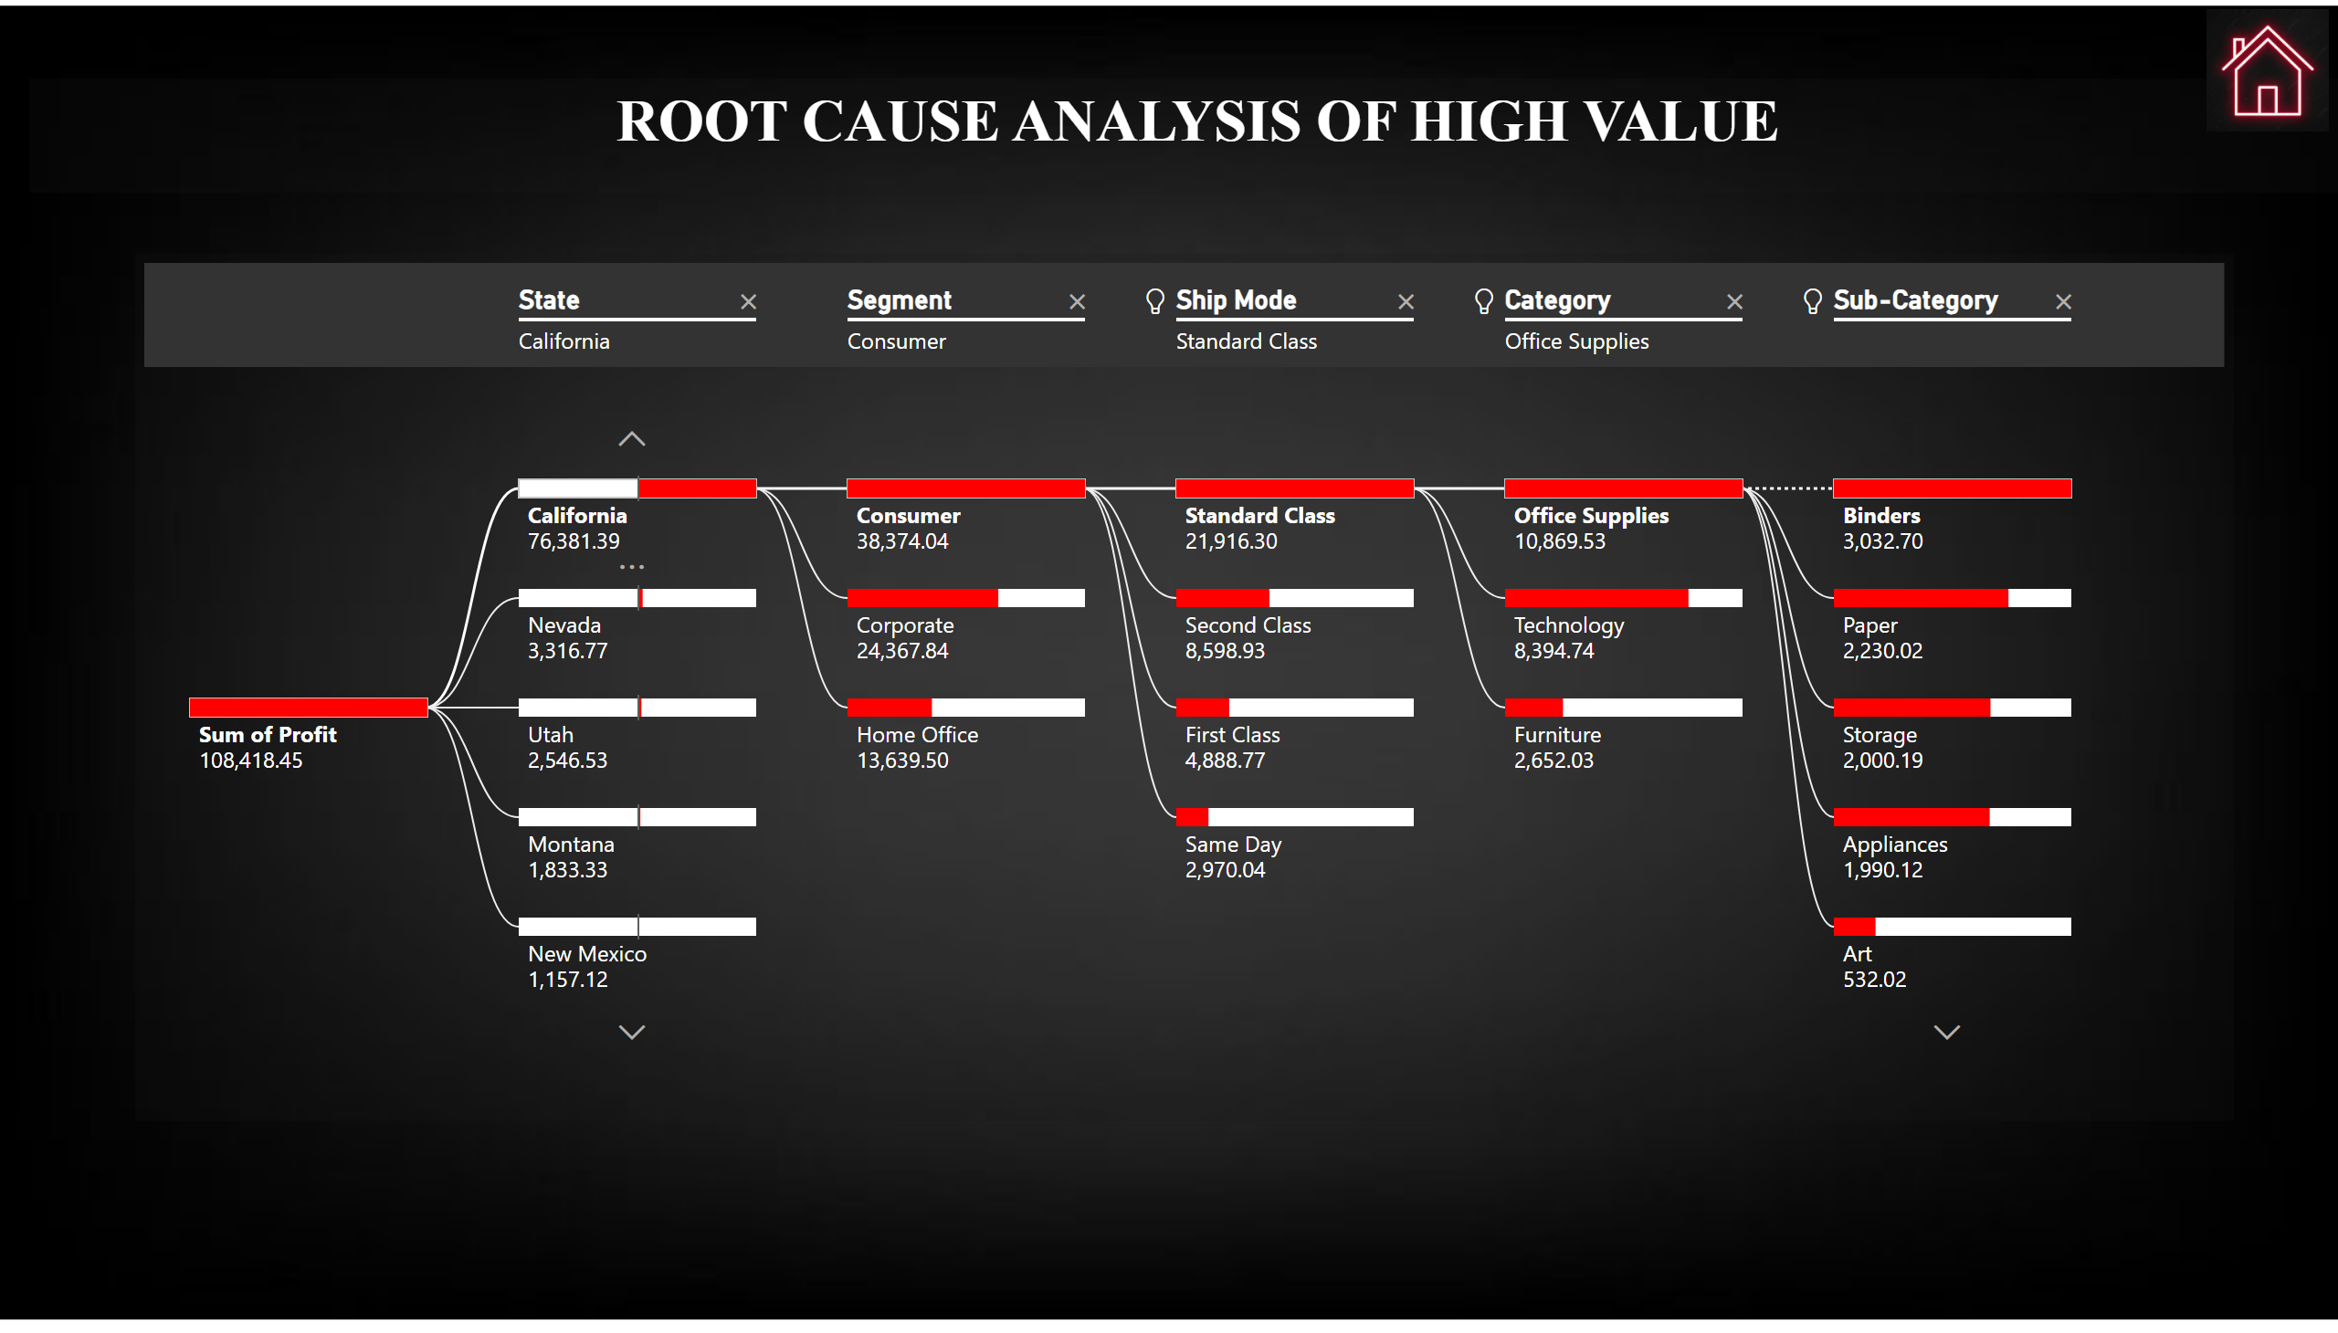
Root Cause Analysis
Notes:
textbox
No alt text provided
decompositionTreeVisual
No alt text provided
image
No alt text provided

Slide 13
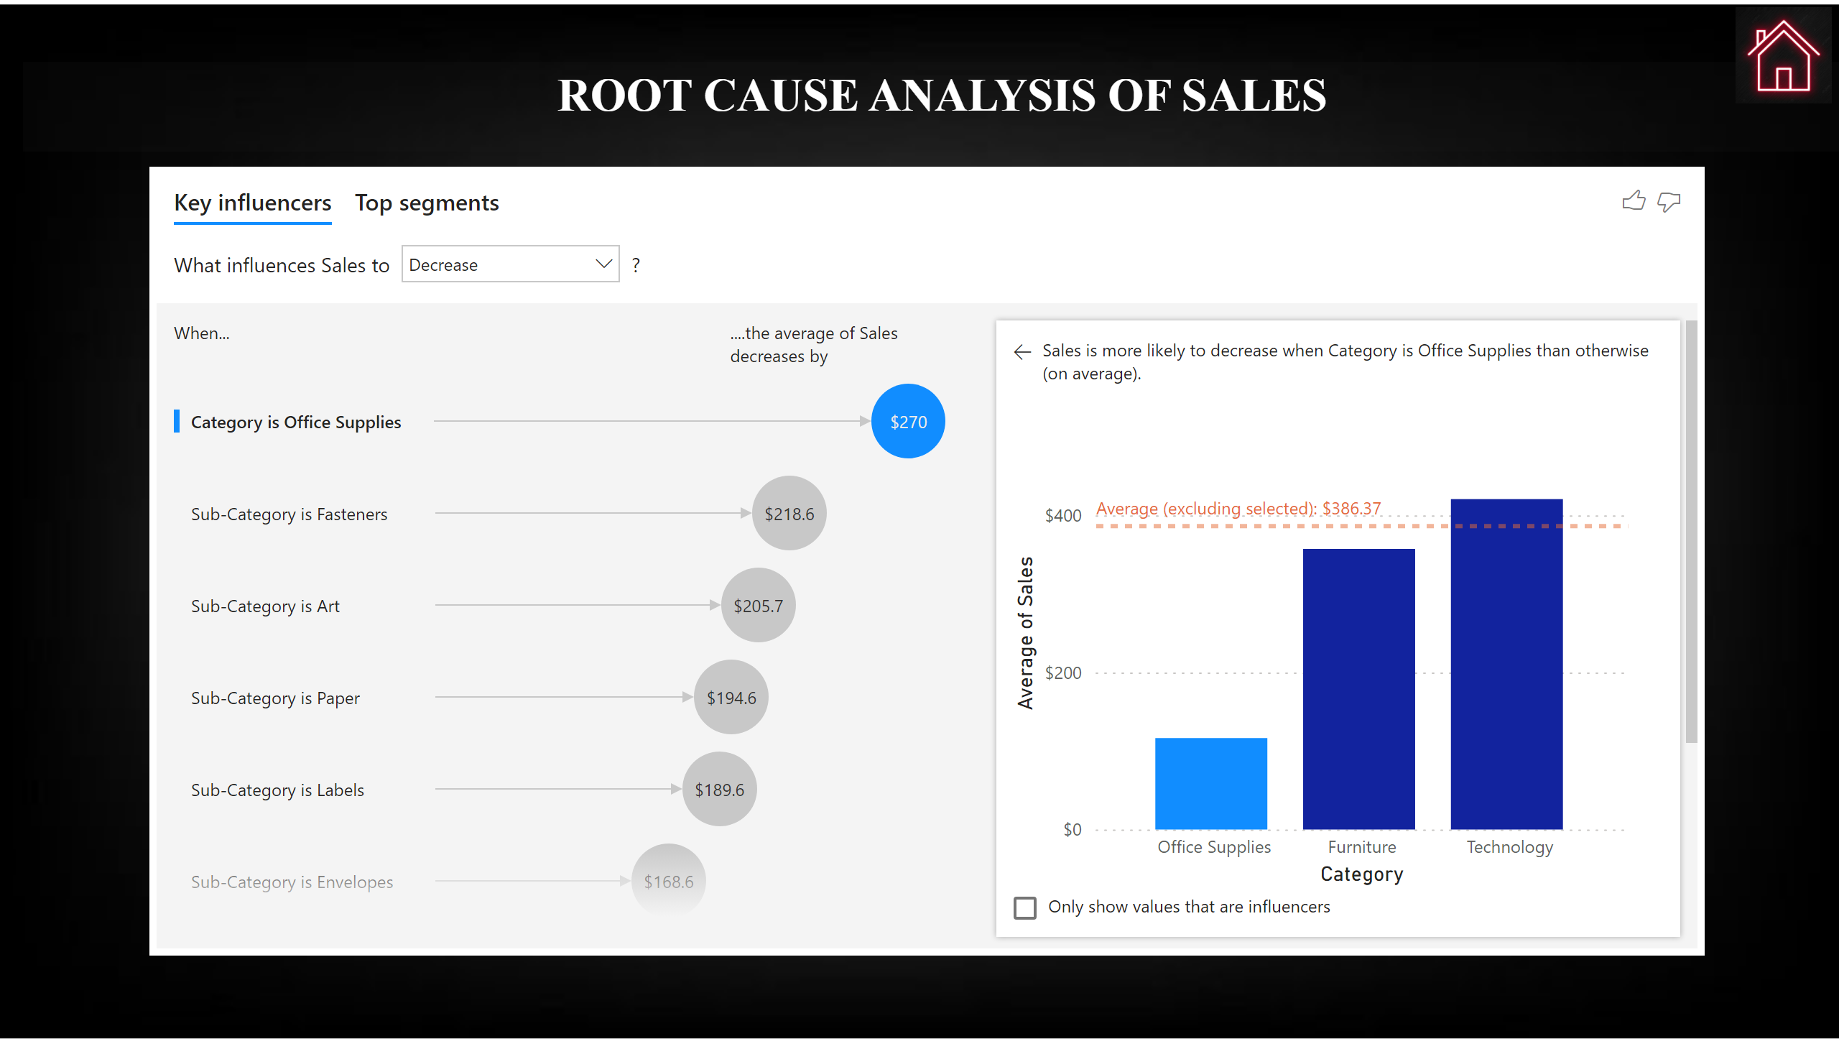
Root Cause Analysis For Sales
Notes:
textbox
No alt text provided
keyDriversVisual
No alt text provided
image
No alt text provided

Slide 14
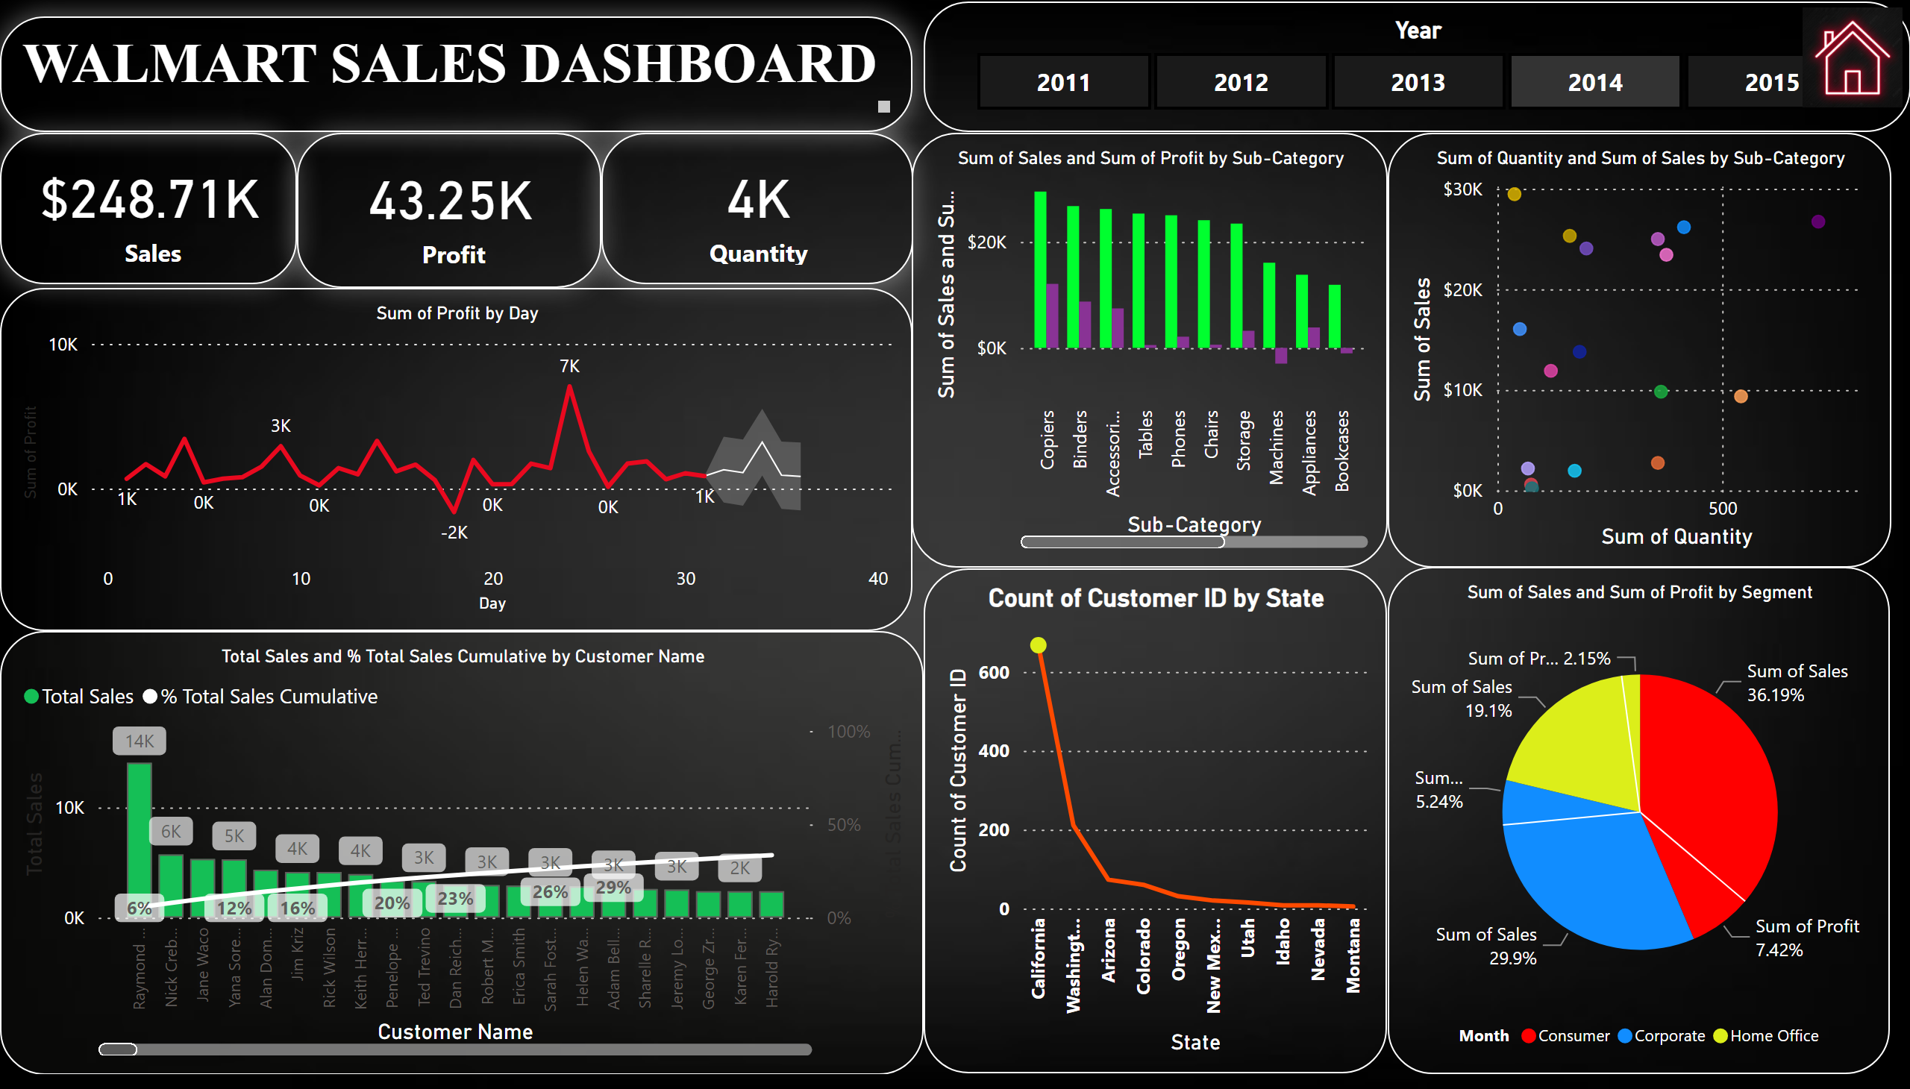
Dashboard
Notes:
Year
No alt text provided
card
No alt text provided
card
No alt text provided
card
No alt text provided
WALMART SALES DASHBOARD
No alt text provided
lineChart
No alt text provided
lineClusteredColumnComboChart
No alt text provided
clusteredColumnChart
No alt text provided
scatterChart
No alt text provided
pieChart
No alt text provided
image
No alt text provided
lineChart
No alt text provided

